Slide 1
Cricket sheet analysis
By
Prasitaa Kannadasan

Slide 2
TECH STACK:
MySQL
PowerBI
ETL using Python
Data Visualization using Python

Slide 3
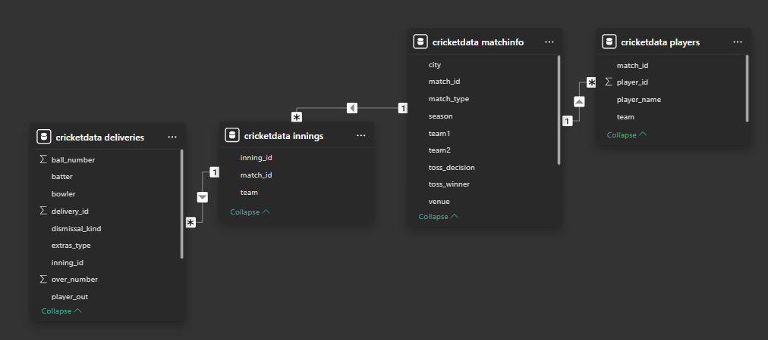
SCHEMA FOR TEST MATCHES

Slide 4
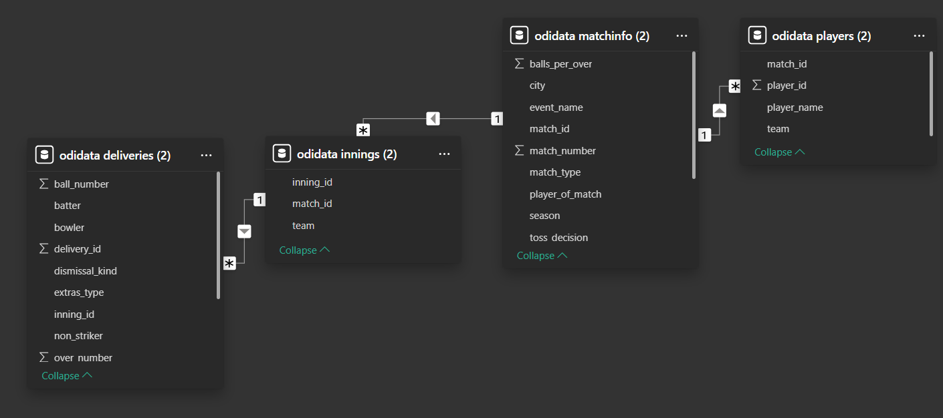
SCHEMA FOR ODI MATCHES

Slide 5
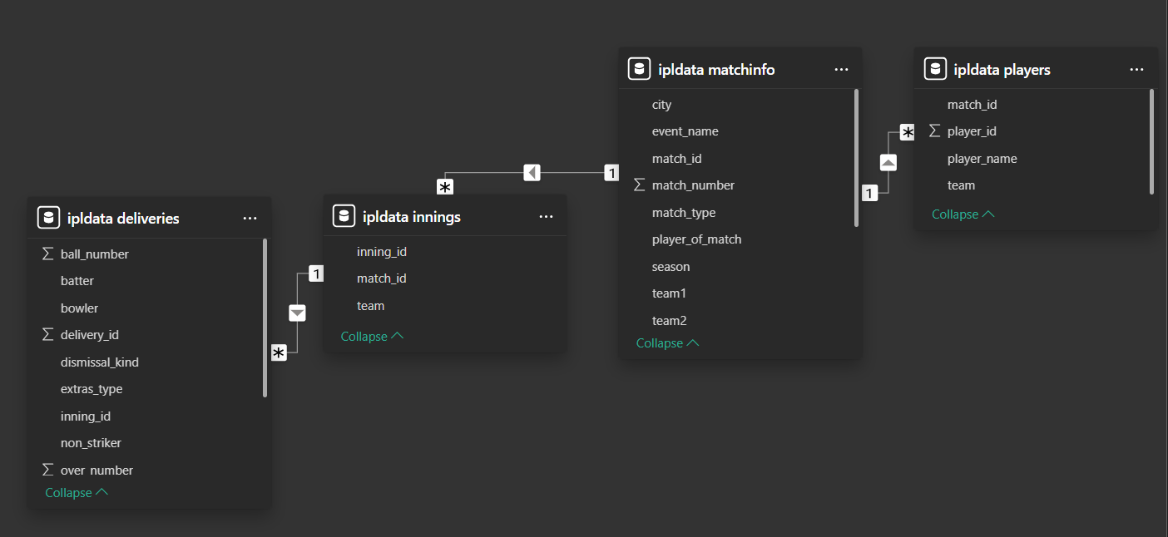
SCHEMA FOR IPL MATCHES

Slide 6
SCHEMA FOR T20 MATCHES

Slide 7
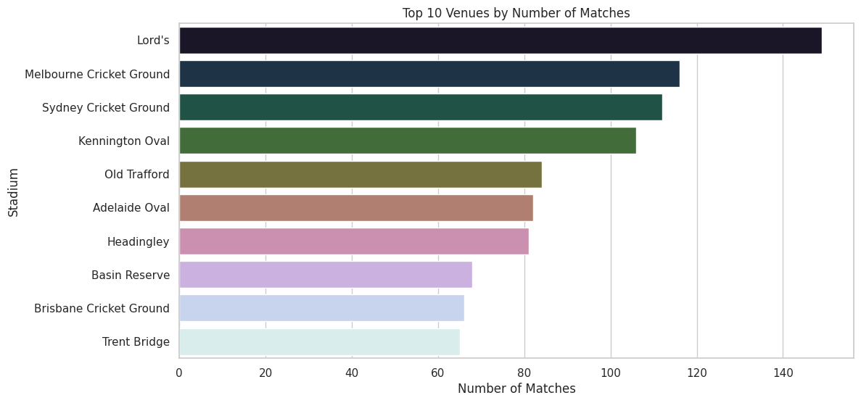
EDA INSIGHTS FOR TEST MATCHES:

Slide 8
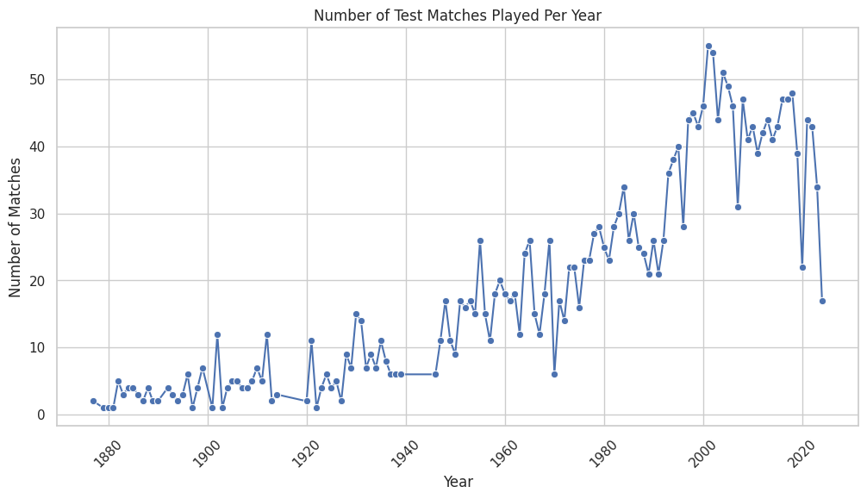
EDA INSIGHTS FOR TEST MATCHES:

Slide 9
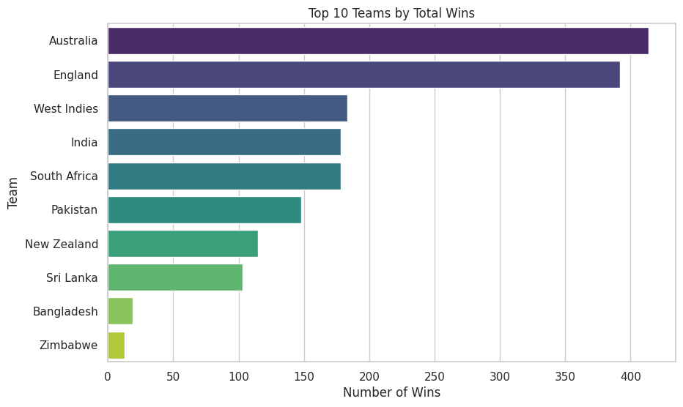
EDA INSIGHTS FOR TEST MATCHES:

Slide 10
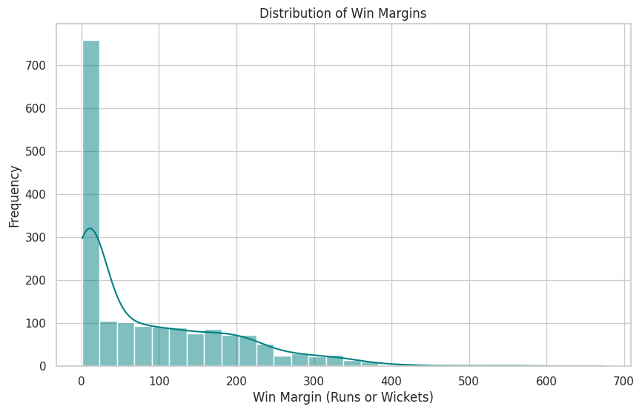
EDA INSIGHTS FOR TEST MATCHES:

Slide 11
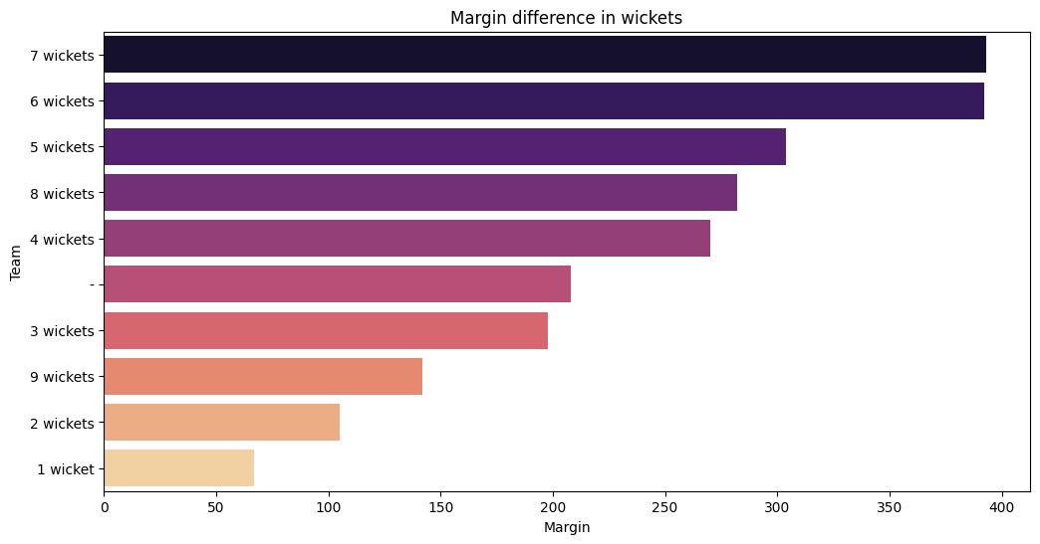
EDA INSIGHTS FOR ODI MATCHES:

Slide 12
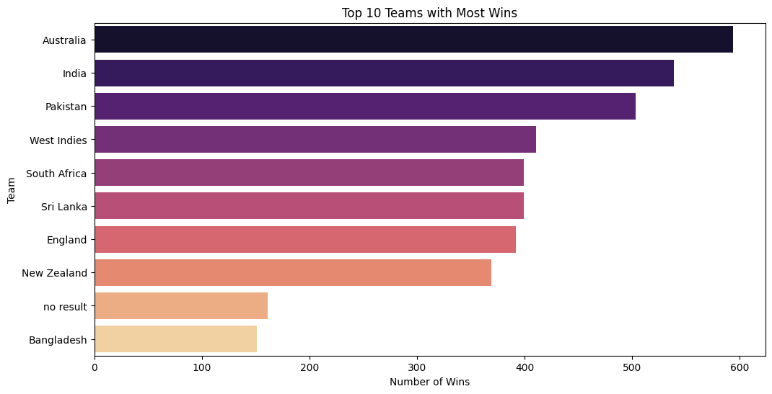
EDA INSIGHTS FOR ODI MATCHES:

Slide 13
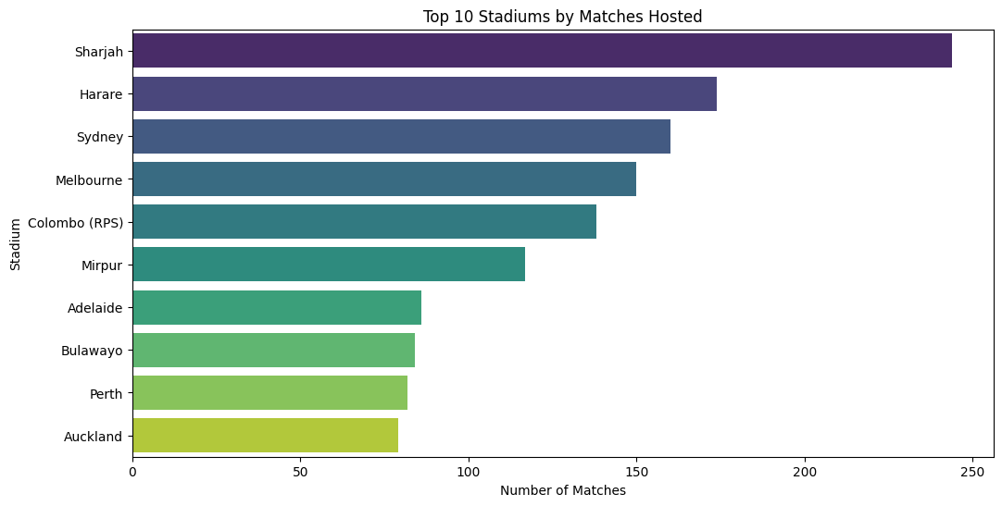
EDA INSIGHTS FOR ODI MATCHES:

Slide 14
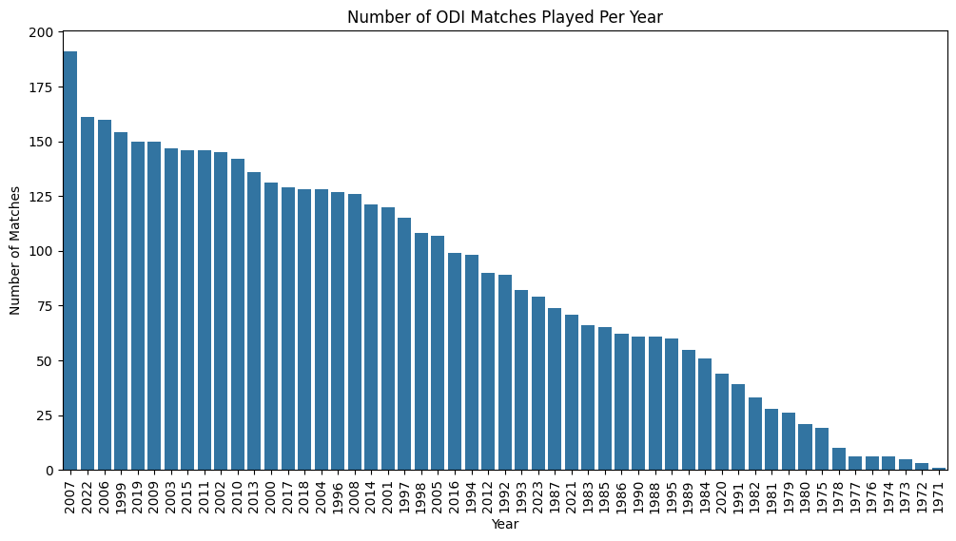
EDA INSIGHTS FOR ODI MATCHES:

Slide 15
INSIGHTS FROM POWERBI:
Top Player
Top Deliveries
Only batsmen
Only bowler
Unique Seasons
Top Innings
Unique Player of the Match

Slide 16
CONCLUSION:
This project encompasses ETL from JSON files into MYSQL Database which is then connected and accessed through PowerBI to get insights and transform the data. Additionally, SQL queries have also been written to get insights but since the dataset is huge, runtime of SQL command takes more time. EDA Visualizations have been done using python libraries like matplotlib and seaborn. Proper documentation and presentation of the project has been done.

